Slide 1
ME469: Course Objectives
Stefan P. Domino^{1,2}
¹ Computational Thermal and Fluid Mechanics, Sandia National Laboratories
² Institute for Computational and Mathematical Engineering, Stanford
SAND2018-4536 PE

Slide 2
Course Goal: Increased Proficiency in Numerical Approaches for Computational Fluid Dynamics
Analysis and implementation of computational approaches applied to the simulation of fluid motion
In this class, we will focus on low-Mach flows in the acoustically incompressible regime
Key ingredients
Approximations: from the real world to a physical/mathematical representation
Computations: from a continuous mathematical model to computer algorithms and, finally, to a discrete solution
Emphasis
Numerical algorithms for fluid mechanics and their implementation
Analysis and understanding of the numerical properties and physical motivation
Verification and Validation (V&V)
Computing and programming are of primary importance
Classes are designed to work from fundamentals of discretization, to supporting complex multiphysics modeling and simulation (Mod/Sim) experience
Weekly lab-like sessions (Friday) will run canonical CFD cases (channels, pipes, jets, etc.)

Slide 3





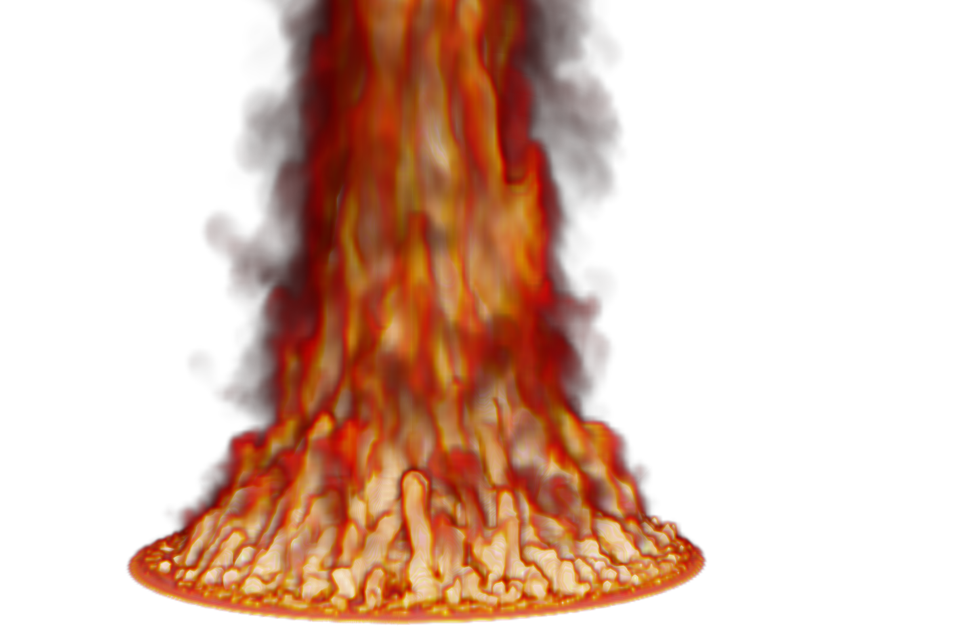
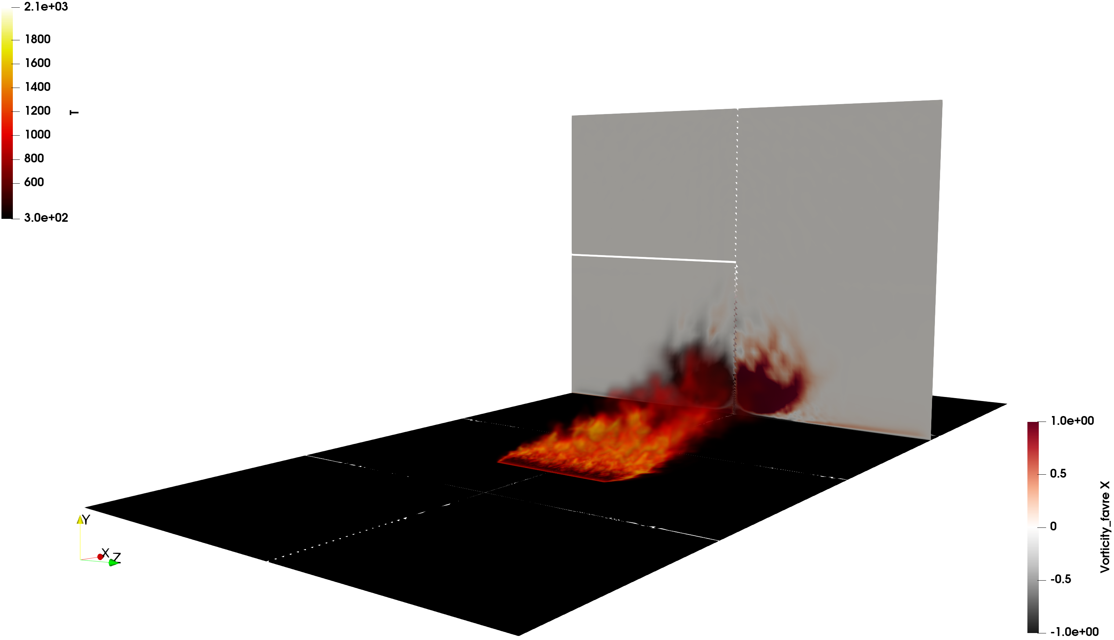
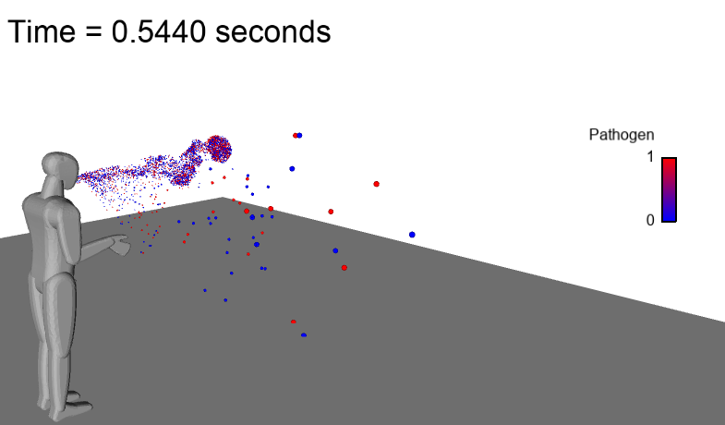





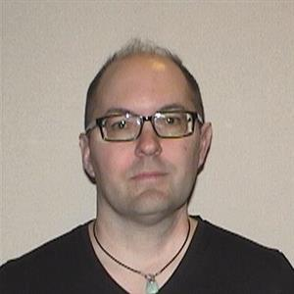
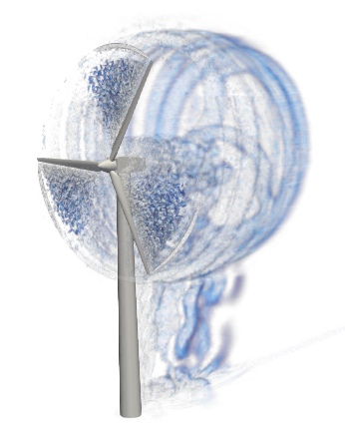
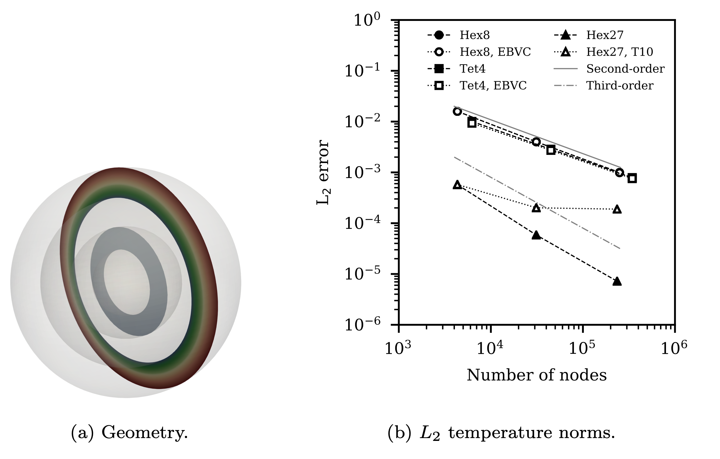



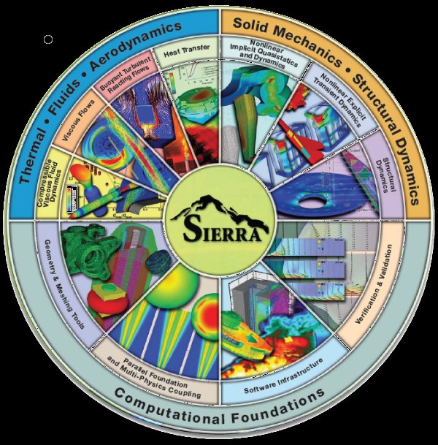
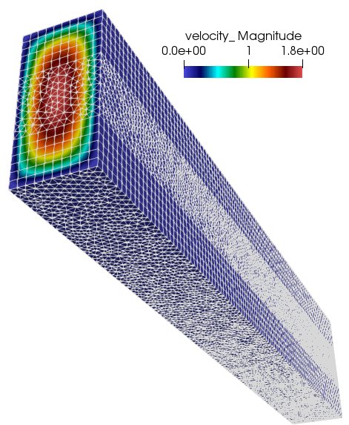


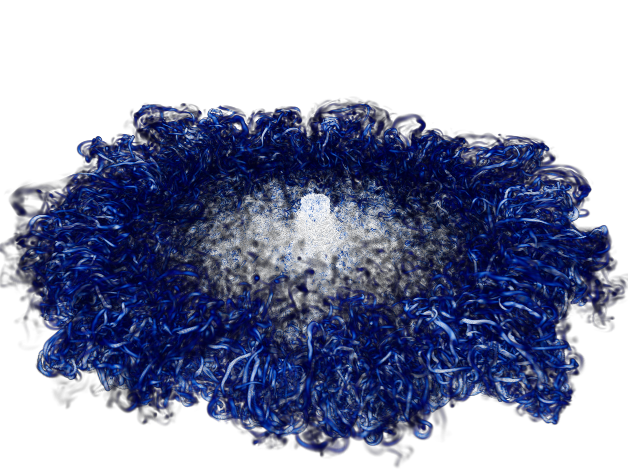

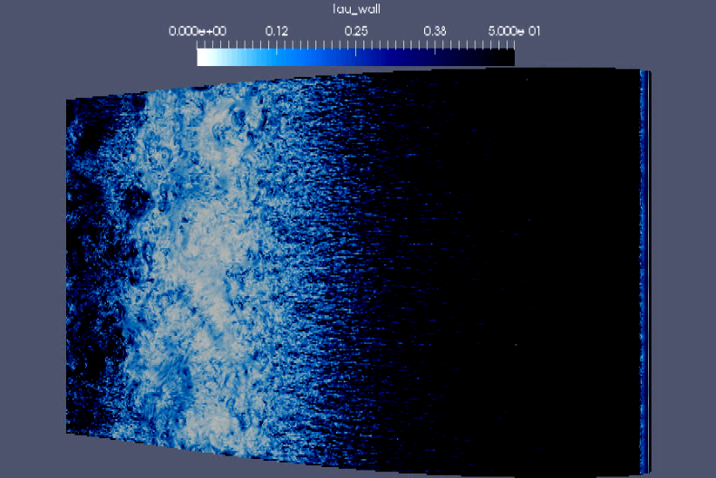
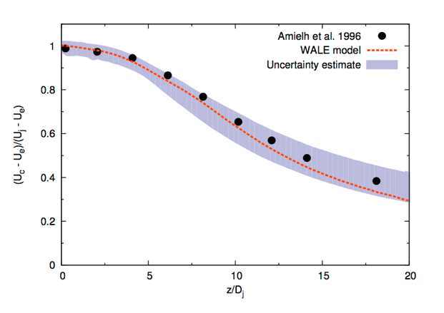

Who Am I? Stefan P. Domino (he/him)
Distinguished Member
of the Technical Staff
Adjunct Professor
Ph.D.
PHYSICS
low-Mach turbulent flows with emphasis on variable density reacting/multi-phase; buoyancy
NUMERICS
Low-dissipation, low-Mach generalized unstructured methods development for LES and DNS
VVUQ
Multi-physics code verification techniques along with structural uncertainty approaches for LES; QoI behavior for fires in crossflow
HPC
Routine massively parallel computing with unstructured, fully implicit mesh counts of O(10) billion elements on 1000-6000 nodes.
CODE
Efficient, clean coding design for modern low-Mach multi-physics applications
Fires, jets, multi-phase (buoyant) physics (COVID-19)
Stefan
Code Verification
github.com/NaluCFD
O(2) billion DNS
O(6) billion WRLES
Ven diagram and concept modified from PresentationGO.com

Slide 4
Course Support
Stefan P. Domino - Sandia National Laboratories, spdomin@stanford.edu
Mark Benjamin – markben@stanford.edu
Steve Jones – Stanford HPC Center stevejones@stanford.edu

Slide 5
Your Turn….
Field of research/interest
Relevant Experience
CFD, Simulation Software, etc.
Programming languages,
HPC libraries, etc.
Supercomputing,
Cluster access experience, etc.
Please provide me with a one-page overview of your name, interests, your background, and a picture

Slide 6
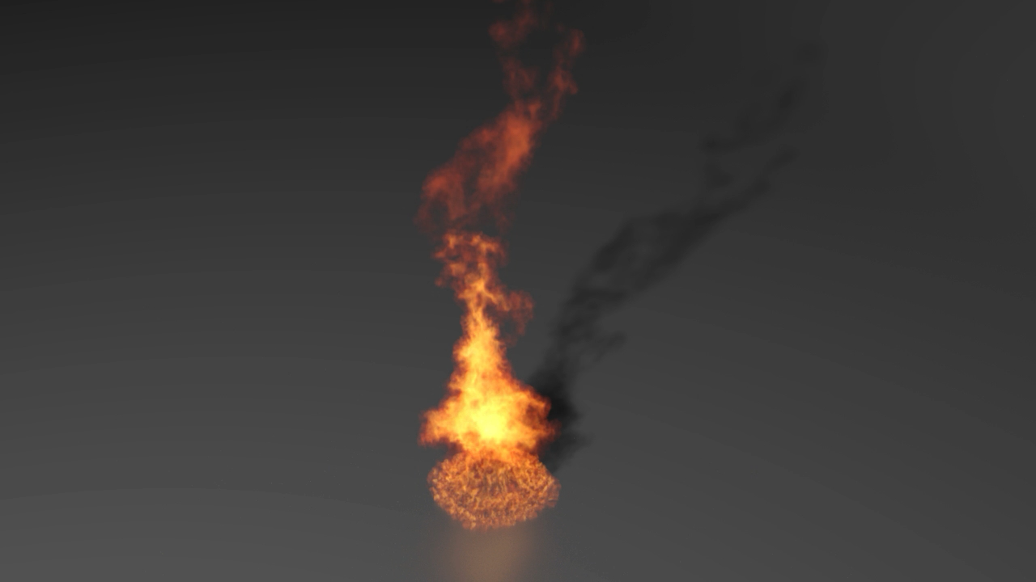
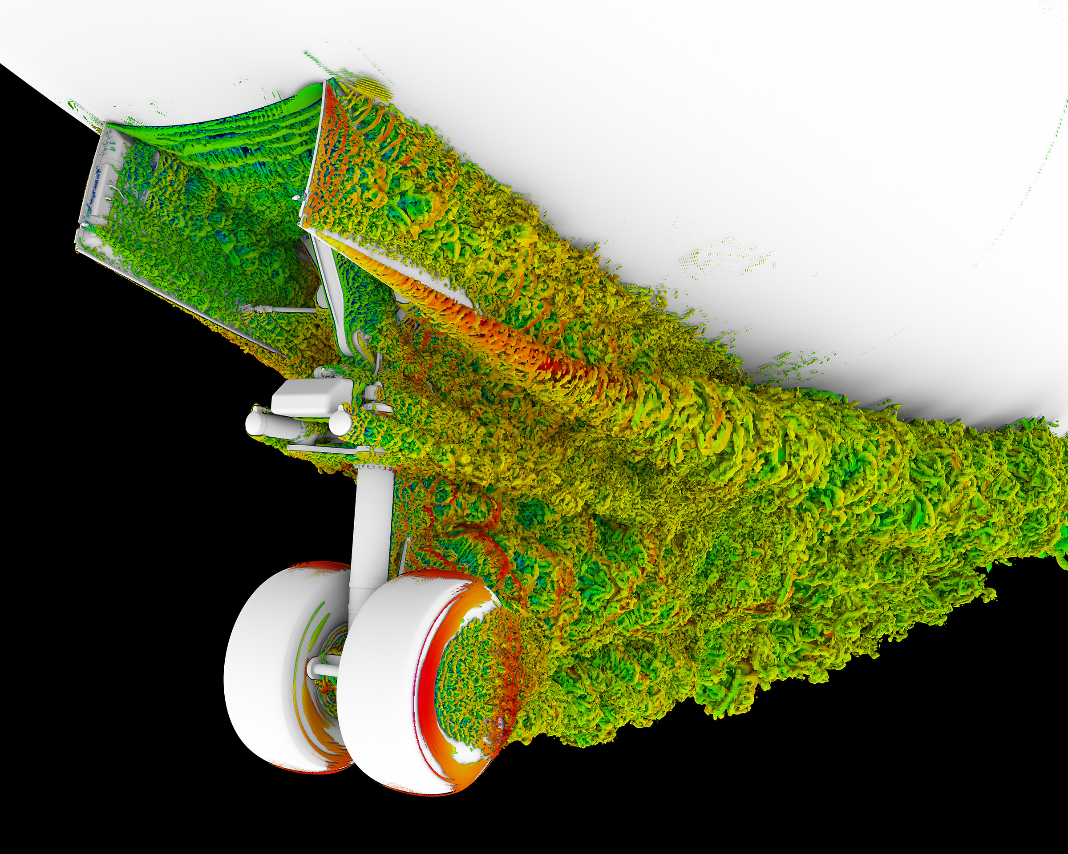
What is CFD?
Computational Fluid Dynamics (CFD) is a branch of computer-aided science that enables numerical simulations and predictions of fluid flow behavior
Mathematical modeling: typically a system on non-linear, coupled partial differential equations (PDEs)
Numerical methods: Involves both discretization and solution techniques
Software engineering: code implementation and software quality assurance (SQA)
CFD software tools are commercially available or accessible as open-source packages, however, research is ongoing to improve the methods, physical models, conceptual understanding, etc.
Five meter pool fire simulation, Domino et al., PoF (2022)
NASA simulation of a flow field around the nose landing gear of a Boeing 777
Image credit: NASA's Ames Research Center, Patrick Moran; NASA's Langley Research Center, Mehdi Khorrami; Exa Corporation, Ehab Fares
Notes:
While aircraft efficiency has improved over the years, noise continues to be a problem for existing aircraft and will likely be a concern for next-generation designs. During landing, when the engines are operating at reduced power, noise from the airframe, including landing gear, can be equal to or greater than the engine noise. This visualization, from a collaboration between NASA and Boeing about airframe noise prediction, shows the simulated air flow field around the nose landing gear of a Boeing 777, representing the complex unsteady flow generated by the gear components. The visualization is colored by speed, from slower green to faster red air velocities. A strong vortex appears coming off the edge of the landing gear doors. Simulations run on NASA supercomputers at Ames allow researchers to better understand the changes in flow behavior that contribute to airframe noise.
Related: NASA is showcasing 35 of the agency’s exciting computational achievements at SC17, the international supercomputing conference, Nov. 13-16, 2016, in Denver, Colorado. To view the featured demonstrations, visit: https://nas.nasa.gov/SC17.
Image credit: NASA's Ames Research Center, Patrick Moran; NASA's Langley Research Center, Mehdi Khorrami; Exa Corporation, Ehab Fares

Slide 7
Milestones in CFD
1910 - Richardson: Forecast Factory: hand calculations with human computers, 2000 operations per week – envisioned to 60,000 humans
1960 - Marker and Cell methods - Harlow & Welch (Los Alamos)
1970 - Finite difference methods for Navier-Stokes
1972 - Reynolds Averaged Navier-Stokes & k-ε models (Imperial College)
1975 - Finite element methods for stress analysis
1980 - Finite volume methods (Imperial)
1980 - Direct Numerical Simulations of Channel Flow (Stanford)
1985 - Routine use in aerospace & aeronautical industries (Boeing, General Electric, ...)
1995 - Routine Use in ”non-aero” industries (GM, Ford, ...)
1996 - ASCI Red (Sandia) reaches 1.3 tera-FLOPS); 10¹² floating point operations per sec
2008 – Roadrunner (LANL) reaches 1.042 peta-FLOPS; 10¹⁵ FLOPS
2023 – Frontier (ORNL) is the first Exascale computer; 10¹⁸ FLOPS
now - widespread use in all industries!

Slide 8
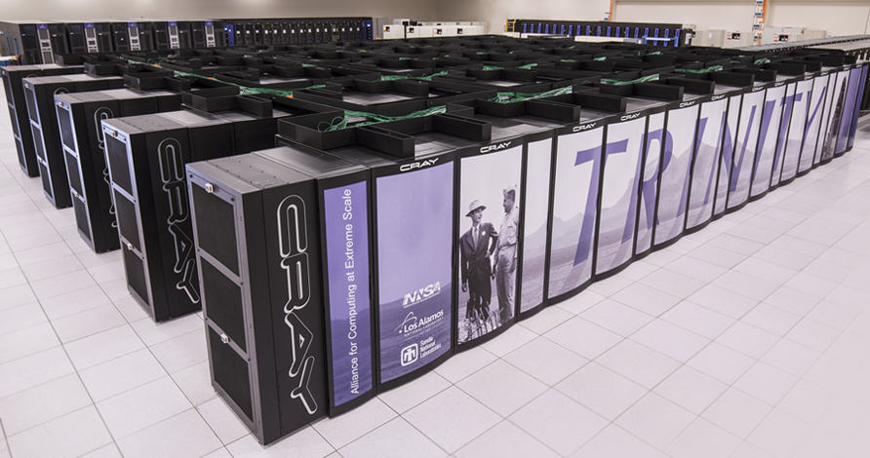
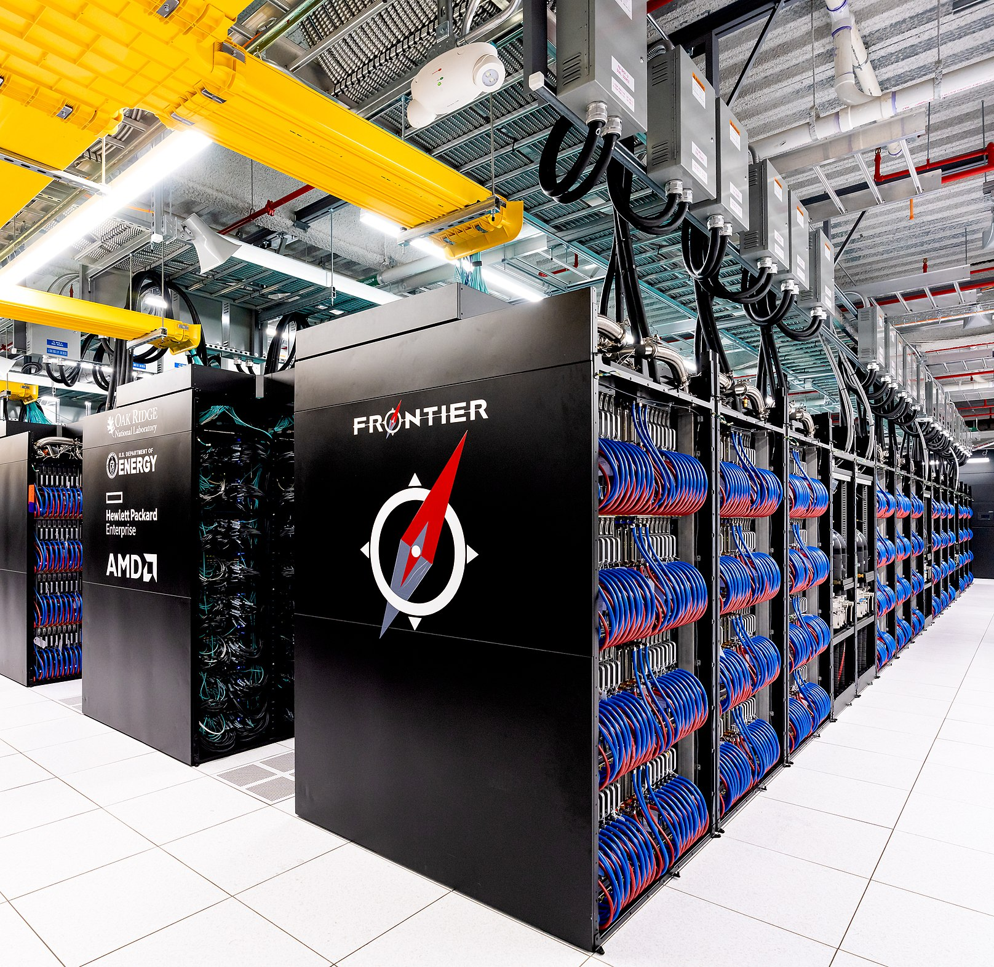
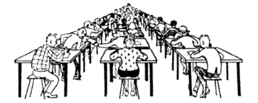
Forecast Factory, Circa 2020
“Richardson foresaw a ‘forecast factory,’ where he calculated that 64,000 human ‘computers,’ each responsible for a small part of the globe, would be needed to keep ‘pace with the weather’ in order to predict weather conditions”.
https://celebrating200years.noaa.gov

Slide 9
CFD & ME469/CME369
Rich tradition of CFD at Sandia and Stanford - this class focuses on:
Introduction to numerical methods and their properties
Fluid mechanics flow equations and approximation levels
Unstructured grid approaches:
Finite volume: Cell-centered, edge/element-based; and Finite Element Methods (FEM)
Hands on experience with edge/element-based and FEM solver
Numerical methods for low-Mach/incompressible flow
Verification and Validation (V&V) methodologies including Uncertainty Quantification (UQ)
Extensions include:
Variable-density flows
High performance computing
Volume of Fluid
Move movement including sliding mesh and overset
Multiphysics couplings
….others

Slide 10
Course Material
In-class Supplied Material
Slides and tutorials will be posted to Canvas (generally, post-lecture)
A new course reader, in partnership with Professor Gianluca Iaccarino, will serve as a supplement to the lecture notes and will be posted to Canvas
Nalu: Open source software documentation
https://nalu.readthedocs.io/en/latest/source/theory/index.html
Optional Textbook(s)
J. Ferziger, M. Peric: Computational Methods for Fluid Dynamic, Springer
H. Versteeg, W. Malalasekra: An Introduction to Computational Fluid Dynamics: The Finite Volume Method, Prentice Hall
C. Hirsch: Numerical Computations of Internal and External Flows, Butterworth-Heinemann
R. Moser: Numerical Methods in Turbulence Simulation, Elsevier
Chapter 7, “Unstructured finite volume approaches for turbulence”, Domino, will be distributed in class

Slide 11
Computational Simulations Tools Exercised
We plan on using the open-source Nalu code base that has already been installed on the dedicated mini-cluster: me469-cluster.stanford.edu
You will receive an invitation to join (SUID)
We are also working to provide linux-based laptops with a Nalu installation to facilitate our laboratory sessions on Fridays (one laptop per 2-3 students)
Visualization: Paraview (open source)
Grid Generation: We have created all of the meshes that you will need for this class. If you have ideas on specific problems that you would like to run, which are tractable given the cluster resources, let us know
If you are familiar with another simulation tool, this code base can also be incorporated in the course
The objective is not to learn Nalu, but rather to have a simulation tool to evaluate and test the concepts provided in class

Slide 12
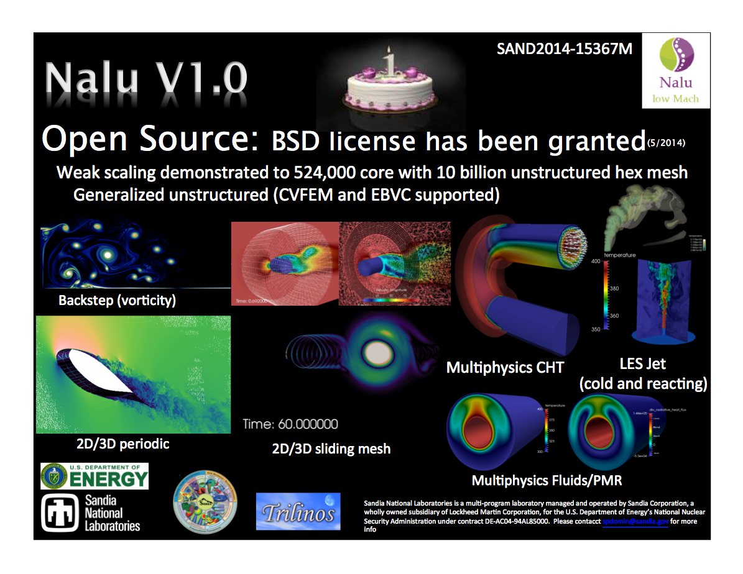
Nalu: https://github.com/NaluCFD/Nalu

Slide 13
Course Grading
Grading
Two laboratory-based write-ups (20%), see: Nalu/reg_tests/test_files/laboratory
You can choose the laboratory writeups including:
1d_quad4_adv_diff 2d_quad9_helium 3d_hex8_open_jet 2d_quad4_channel 2d_tri3_quad4_street 3d_tet4_pipe 2d_quad9_couette 3d_hex8_dam_break
Format will be a brief report, i.e., ~5 pages and can follow the write-up approach (LaTex), or your document editor program of choice (provided as pdfs)
Midterm (40%): ~10 page report
Focused on the 2d_tri3_quad4_street case
Final (40%): ~10 page report
Late submissions are discouraged and allowed only under special circumstances

Slide 14
Labs and Projects: Designed to Remove the Meshing Requirement of CFD
Midterm Project: Discussed in third laboratory session
Flow around a circular cylinder (2D vortex street), see:
Nalu/reg_tests/test_files/laboratory/2d_tri3_quad4_street/write_up/2d_tri3_quad4_street_laboratory.pdf
Focuses on numerical accuracy and parametric sensitivities
Final Project: Focus on physics investigation; cases documented in the course reader
Flow/Thermal analysis, see Nalu/examples (hula hoop)
Rotating shapes, see Nalu/examples (shapes)
If you have other ideas, let me know by week 6
Logistics
Projects can be carried out as a team (2-3 members max)
Reports no longer than 10 pages, however, should read like a manuscript, e.g., introduction, theory, numerical experiments, findings, conclusion
You can also propose using an alternative CFD code base
Please avoid AI-based usage!

Slide 15
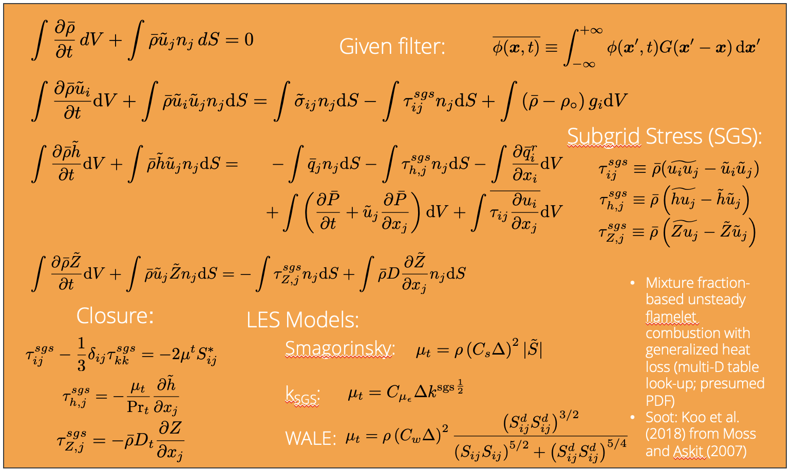
Incoming Expectations
Familiarity with:
Basic Unix commands
>ls, cd, pwd, mv, cp, rm, ...
See, for example, http://www.ee.surrey.ac.uk/Teaching/Unix/
Editing a file under a Unix environment
vi, emacs, etc.
Numerical methods including:
Explicit/Implicit
Finite difference, finite volume, finite element, etc.
Programing language can be useful
Fluids mechanics and the underlying PDE set
Reporting tool, e.g., LaTex, Word, etc.
ME300C or similar (fundaments of numerical methods)
ME351a/b or similar (fluid mechanics)

Slide 16
Questions?

Slide 17
Useful Abstractions
Real World
The intended application
Physical laws, hypothesis and models (e.g. a set of PDEs) and initial and boundary conditions
A set of computational algorithms that allow to build a numerical, or approximated solution to the conceptual model
Conceptual
Model
Computer Model

Slide 18
Mappings:
Real World
Conceptual
Model
?
Computer Model

Slide 19
Qualification: Adequacy of the conceptual model to provide an acceptable level of agreement for the intended application
Real World
Conceptual
Model
Examples:
Is the fluid Newtonian?
Are compressibility effects important?
Uniform or variable-density?
Isothermal or non-isothermal?
Computer Model

Slide 20
Verification: Process of determining that (1) the model implementation faithfully represents the conceptual model (without mistakes) and (2) the solution to the model is accurate
Real World
Conceptual
Model
Examples:
Is it RHS += A, RHS -=A? Which is correct?
Should the contribution be scaled by a volume?
How does the Quantity of Interest (QoI) behave as a function of mesh or time step resolution?
Verification
Computer Model

Slide 21
Validation: Process of determining the degree to which the numerical solutions (hence the model) is an accurate representation of reality from the perspective of the intended application
Real World
Conceptual
Model
Validation
Examples:
Midterm project: compare drag coefficient prediction to an experiment
Final project: compare drag coefficient for flow past rotating shapes; chaotic flow prediction at a given configuration
Computer Model

Slide 22
Verification vs Validation (V&V)? The Formal Lexicon
Verification: Are we solving the equations correctly?
Represents an exercise in computational mathematics
Given an equation, is the solution converging at known rates?
Validation: Are we solving the correct equations?
Represents an exercise in understanding the physics associated with the real world use case
In this course, we will strongly focus on verification
Establishing the correctness of the numerical implementation is key
Comparisons of the numerical results to reality is not the primary objective
Verification challenges?
Knowledge of the true solution, i.e., exact analytical solutions
How many exact solutions exist for our class of physics? Not many!
Hint: Method of Manufactured Solutions (MMS)

Slide 23
The Construction of a Numerical Method: Discretization and Solution
Mathematical Formulation
Partial differential equations (PDE)
Initial Conditions (IC)
Boundary Conditions (BC)
Conceptual
Model
Computer Model
Real World

Slide 24
The Construction of a Numerical Method: Discretization and Solution
Mathematical Formulation
Partial differential equations (PDE)
Initial Conditions (IC)
Boundary Conditions (BC)
Numerical Formulation
Discretize in space and time
Algebraic Differential Equations (ADE)
Conceptual
Model
Computer Model
Real World
Discretization step

Slide 25
The Construction of a Numerical Method: Discretization and Solution
Mathematical Formulation
Partial differential equations (PDE)
Initial Conditions (IC)
Boundary Conditions (BC)
Numerical Formulation
Discretize in space and time
Algebraic Differential Equations (ADE)
Numerical Solution
Algebraic Differential Equations (ADE)
Linear solvers
Convergence, mesh adequacy, ….?
Conceptual
Model
Computer Model
!Real World
Discretization step
Solution step

Slide 26
Numerical Simulation Conundrum
PDE
Exact
Solution
What we would like to have…

Slide 27
Numerical Simulation Conundrum
PDE
ADE
Exact
Solution
Numerical
Solution
What we would like to have…
What we have….

Slide 28
Numerical Simulation Conundrum
PDE
ADE
Need to relate the numerical solution of the discretized problem to the exact solution of the original continuous problem!
Exact
Solution
Numerical
Solution
?
What we would like to have…
What we have….

Slide 29
Numerical Simulation Conundrum
PDE
ADE
Consistency
Stability
Exact
Solution
Numerical
Solution
Convergence
For a well-posed, linear PDE, Lax-Richtmyer Equivalence Theorem, AKA the Fundamental Theorem of Numerical Analysis: Consistency+Stability = Convergence

Slide 30
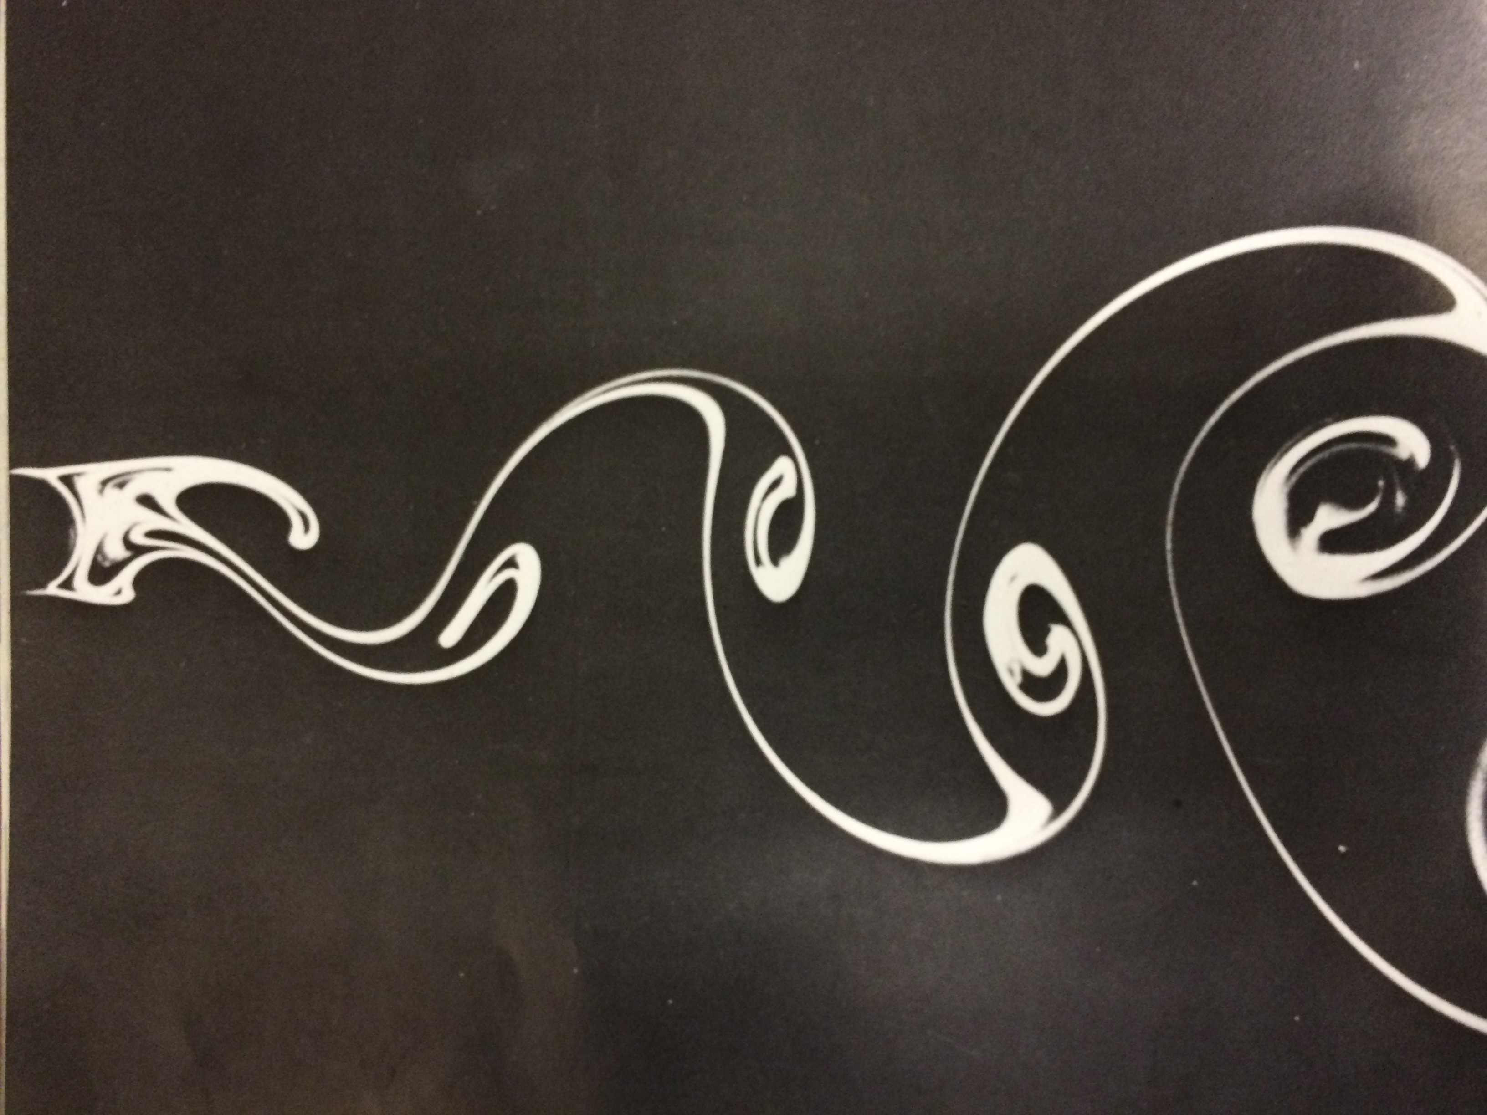
Example 1: Vortex Street
Conceptual
Model
Computer Model
Real World?

Slide 31
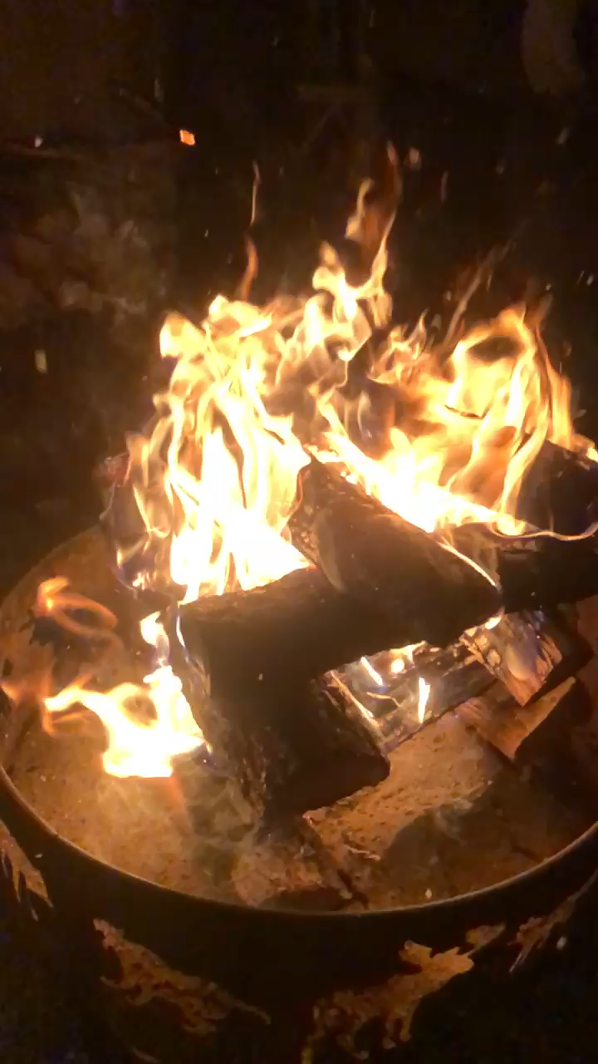
Example 2: Modeling a Luminaria – In the Snow!
Conceptual
Model
Computer Model
Real World?

